Slide 1
Introduction to ukhc
risk management
Margaret m. pisacano
bsn, jd, cphrm
director, risk management
Associate general counsel
Paula j. Holbrook
rn, bhs, jd, cphrm
Associate director, risk management
Associate general counsel
HANS HERKLOTZ, JD
LITIGATION COUNSEL
2023 NEW EMPLOYEE ORIENTATION

Slide 2
LEARNING OBJECTIVES
What Risk Management is, who we are, what we do and how and when to contact us
How to communicate under the Patient Safety Act
Understand patient rights and responsibilities

Slide 3
About uk healthcare risk management
WHO ARE WE?
Margaret Pisacano, BSN, JD, CPHRM
Director of Risk, Deputy General Counsel for Medical Risk
Vanderbilt University, BSN, and law degree from University of Kentucky; extensive medical malpractice defense law and litigation practice, licensure representations
Hans Herklotz, JD Litigation Counsel​ Eastern Kentucky University, history and chemistry; JD University of Kentucky; extensive litigation, state agency and risk management experience​
Paula Holbrook, RN, BHS, JD, CPHRM
Associate Director of Risk, Associate General Counsel
UT/Fort Sanders School of Nursing, RN; BHS & law degree from University of Kentucky; experience in defense law, risk and compliance; state agency representation and fraud prosecution
Christie Young, RN, BSN, MPH, CPHRM Clinical Risk Manager
BSN and MPH at University of Kentucky, nursing experience in labor and delivery, pediatrics, and Office of Patient Experience
Jody Perry, RN, BSN Clinical Risk Manager
Clinical background in Obstetrics/Gynecology, Surgical Services as well as experience as Nurse Paralegal

Slide 4
What does risk management do?
Role of ukhc risk management
ADVISE AND INTERPRET on a variety of legal and clinical issues daily
DEFEND
Manage and oversee all medical malpractice actions
Defense assigned to outside counsel: we oversee, coordinate, strategize, work closely with counsel from filing to resolution
COUNSEL
Counsel and support UK HealthCare physicians, nurses, administrators and staff on a variety of legal issues that impact care
Interpret statutes, regulations and policies
INVESTIGATE
Conduct, coordinate and collaborate clinical investigations
Notice per IR process
Nurses, faculty, house staff, customer relations
Patient or family complaints
Notice from outsiders, such as state and federal agencies, attorneys, licensure or accrediting agencies

Slide 5
Why is risk management important?
Promotes delivery of timely, high quality compassionate care
Promotes risk avoidance and mitigation
Early intervention enables UK Healthcare to treat fairly all those involved
Early intervention with patients and families promotes understanding and resolution before litigation is contemplated
Risk management supports the important work you do

Slide 6
Office: 859.257.6212
Margaret cell: 859.229.7188
Paula cell: 859.333.0461
When should I contact risk management?
For legal issues:
You are contacted by an attorney or receive a legal document, such as a summons, complaint, subpoena or are asked to give a deposition
When you don’t know legally what you can or should do
You have any questions that either Margaret or Paula might be able to answer. Use us as the Risk hotline.
For clinical issues:
When an event with an unanticipated adverse outcome occurs or when a process failure results in patient injury, death or near death causes or nearly causes death or patient injury (TJC “permanent loss of function”)
The earlier the contact the better

Slide 7
Risk management at ukhc
Why report an incident?
reporting an incident
Communicate - Notify leaders of concerns
Improve care
Prevent harm
COMPLY with law, TJC, policy
Correct problems
Record facts and contacts regarding occurrences that may result in legal action

Slide 8
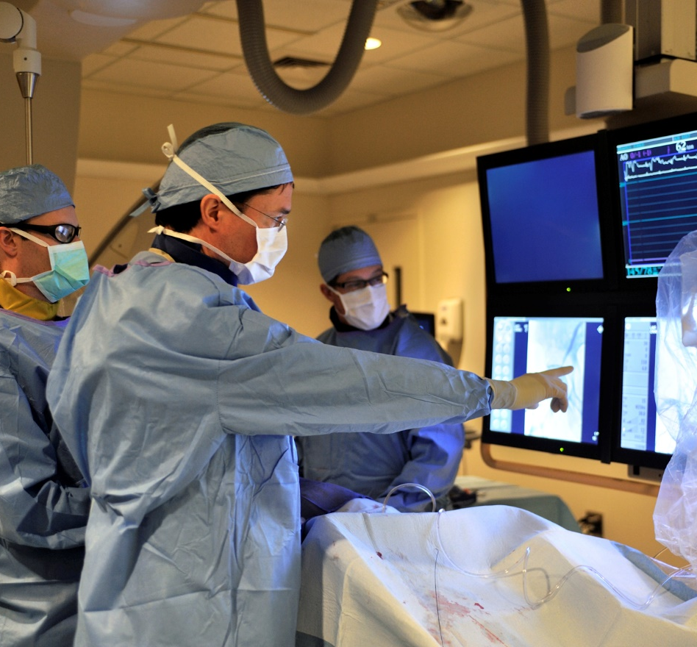
Communicating under patient safety act
Risk management at ukhc
Protecting Patient Safety Work Product (PSWP)
For email:
Please use email judiciously, ensure that the information is clinically appropriate, and contains the minimum necessary PHI under HIPAA.
Include “PSWP” in the "cc“ line of the email only for quality, safety or risk concerns (as if PSWP were an individual)
Emails will go to “pswp@uky.edu” address for review by Risk and placement in our secure PSWP repository
For documents/PowerPoints:
Documents containing patient safety work product should include PSWP language and be sent to pswp@uky.edu
Add PSWP language to the document:
“The information contained herein has been compiled as part of UK HealthCare’s Patient Safety Evaluation Systems with the intent to submit to UK Healthcare’s PSO, is deemed to be Patient Safety Work Product, and is privileged and confidential.”

Slide 9
pswp@uky.edu
Simple Rule
To protect a communication, document or data as Patient Safety Work Product, so that it can’t be produced in a lawsuit or to someone outside of UK, send it to the pswp@uky.edu address
Risk Management is responsible for sorting all information to submit it to our Patient Safety Organization

Slide 10
Business documentation
Incident reporting, email, medical records:
Timely
Objective
Factual
Non-emotional
Professional

Slide 11
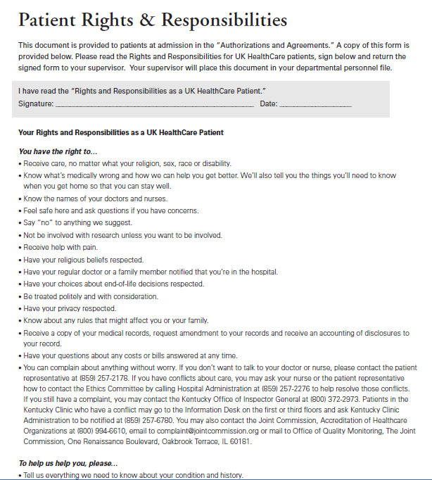
Patient rights and responsibilities
Risk management at ukhc
Patients are given a copy of their rights and responsibilities on admission, when they sign their admission content form (“Authorization and Agreements”)
Please read and sign this form in your packet and give it to your supervisor.

Slide 12
PATIENT RIGHTS AND RESPONSIBILITIES
Risk management at ukhc
Patients have the right to be treated the same as everyone else, irrespective of their membership in protected class
Patients are given sufficient information to make informed decisions about their care (i.e., informed consent)
Patients know who their doctor and who other care providers are
Patients know about, and are involved in, their treatment plan
Patients can refuse treatment
Patients can have visitors, as long as the visitors don’t interfere with the rights of others
Patients can have access to their belongings, as long as the belongings don’t put the patient or others at risk
Patients have a right to privacy and expect their privacy to be respected
Patients expect to be treated with dignity and respect
Patients expect their treatment to be confidential

Slide 13
PATIENT RIGHTS AND RESPONSIBILITIES
Risk management at ukhc
Patients have the right to be protected from abuse, neglect and exploitation.
If you suspect a patient has been abused, neglected or exploited:
You must report to your immediate supervisor and the HOA and DCN
You must also report to Risk Management and Social Services
You should report via SI (online incident reporting system)
We may be required to report to UKPD
A prompt investigation will be conducted and a report generated to the Cabinet for Health and Family Services

Slide 14
Questions?
Ukhc risk management
Office: 859-257-6212
Margaret Cell: 859-229-7188
Paula Cell: 859-333-0461

